Slide 1
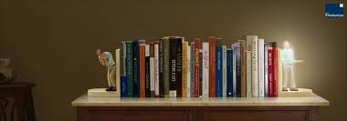
What makes a book spiritual?
An exploration from cave paintings to the cloud

Slide 2

What do you think makes a book spiritual?
What are the characteristics?
What are example of these?
Notes:
Have the students write down their thoughts
Example- talks about death, afterlife, morality, how to life
Can things that are not spiritual be present? And if so what are they

Slide 3
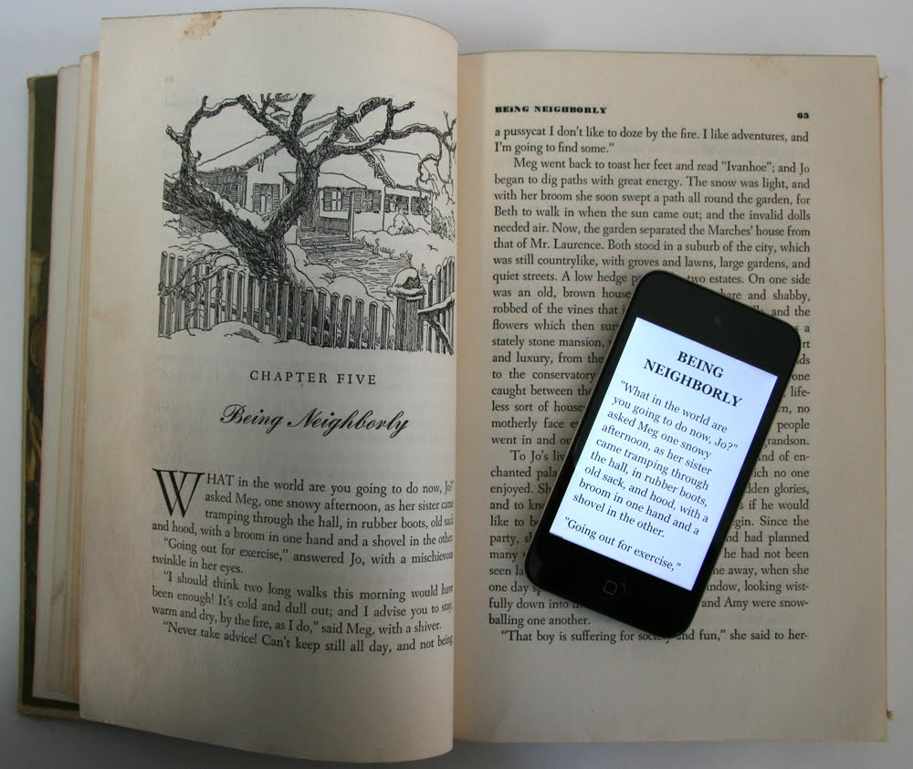
What is a book?
Notes:
What are its elements?
Is it media?
Is it the idea behind the book?
Who can own the book?

Slide 4
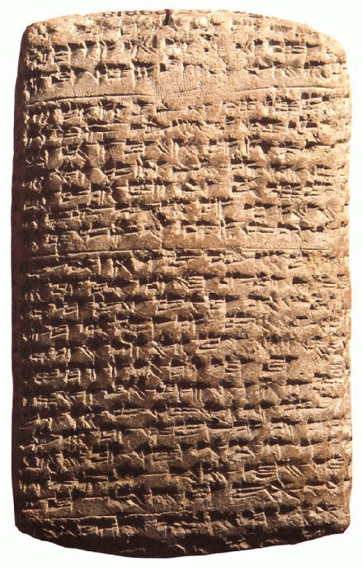
History of Writing
Notes:
Pictographs used for religous items like graves
Pictographs
Cuneiform
Used for business
Cuneiform used to show units/ Counting

Slide 5

Medium of early writing
Stones
Bone
Silk
Bamboo
Dried palm trees
Clay
Papyrus
Parchment
Paper
Notes:
Media needs a medium
Early cave painting- is this spiritual
See if students can figure out where each were used

Slide 6
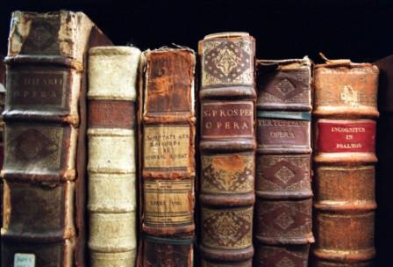
What do you think they wrote about?
What are the oldest books that you can name
Notes:
Big Epic poems like Odysey
Heroic tales like Gilgamesh
Stories more than spiritual practices
Rules and laws coding out morality

Slide 7
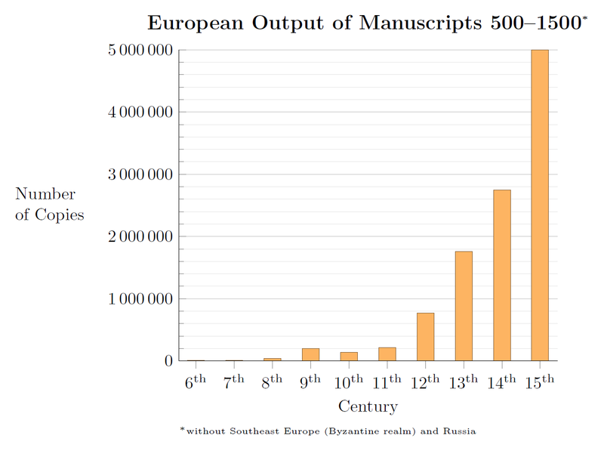
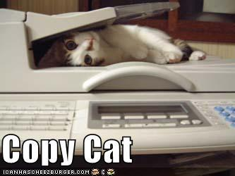
Copy cats
At first books could be copied freely
No idea of ownership
Patrons usually financed books
No job as writer
Notes:
Monks copy texts
Luke and Acts were commishened

Slide 8
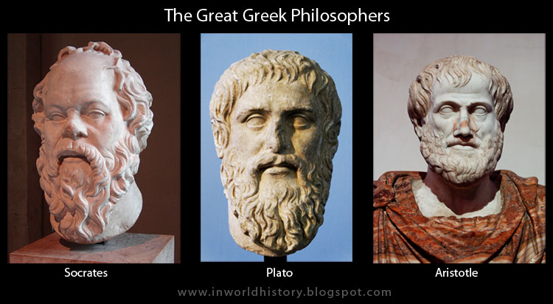
More than in your philosophy
Notes:
Early works were philosohpy
Pythagoras
Plato -soul mates
Morality of stoics
Censorship starts
Even book burnings of Christian texts
why do you people burn books?

Slide 9
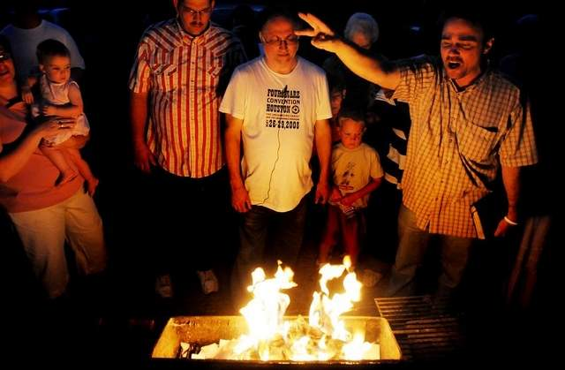
If the book is burned in a forest
Does it cease to exist?
Notes:
Is a book a physical thing or an idea
Why do we burn books but not other mediums??
If you have read a book do you have ownership of the book

Slide 10
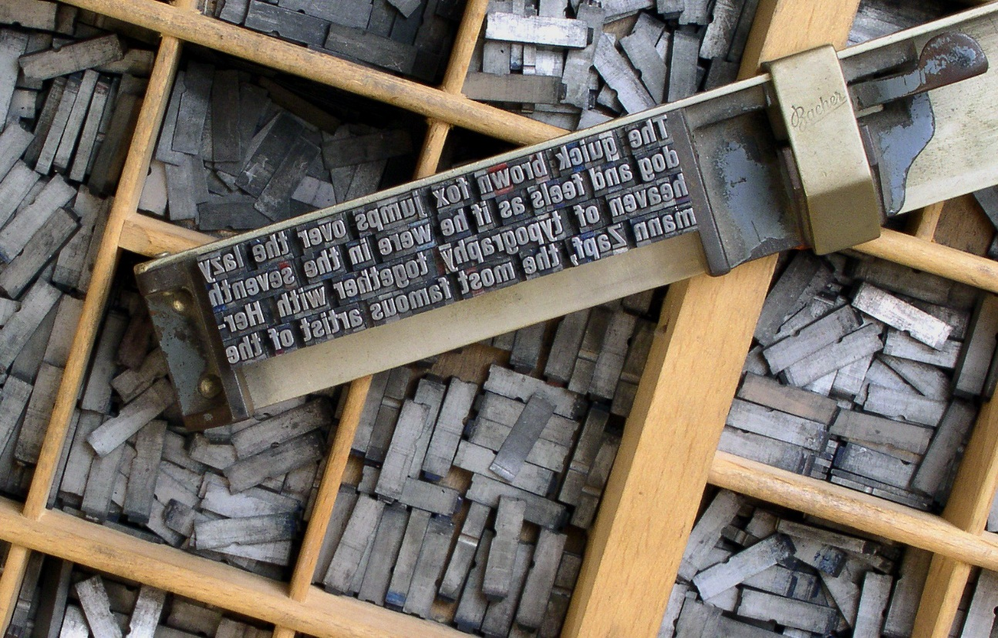
Moveable type
Notes:
Bible was first book created
Allowed to mass produce
Around the time of Luther
Did Luther idea's about spirituality cause this movement?

Slide 11
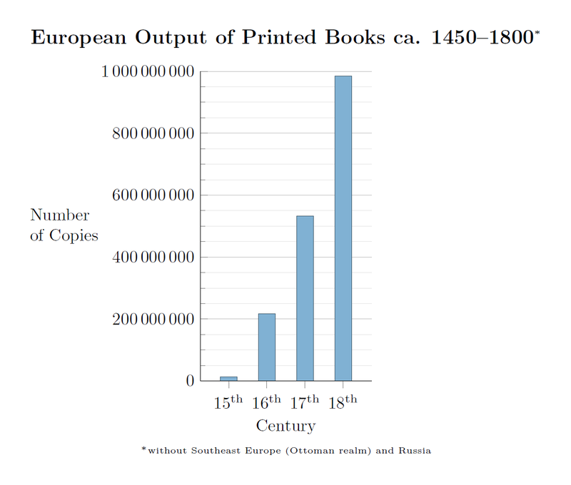
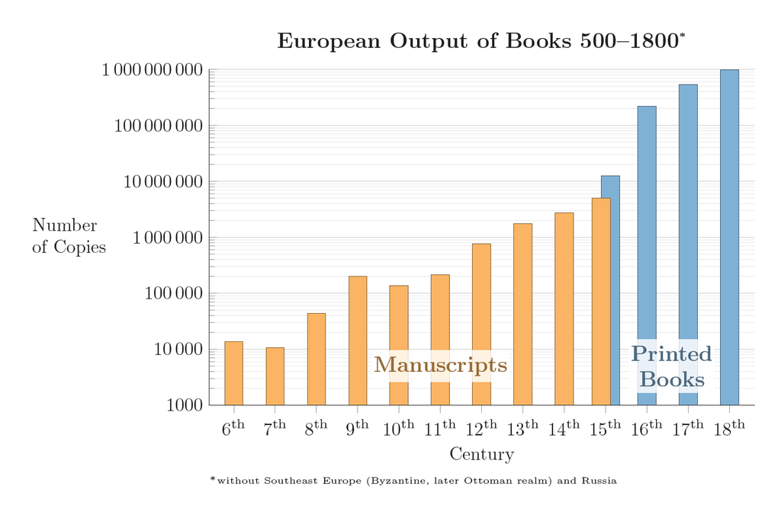
Growing copies

Slide 12

The new idea of Language
Notes:
Dictionaries bring about the idea of a fixed language
Books are physically different
Brings about the ideas of translation
Brings about the problems of translation
Is a translated book still the same book

Slide 13
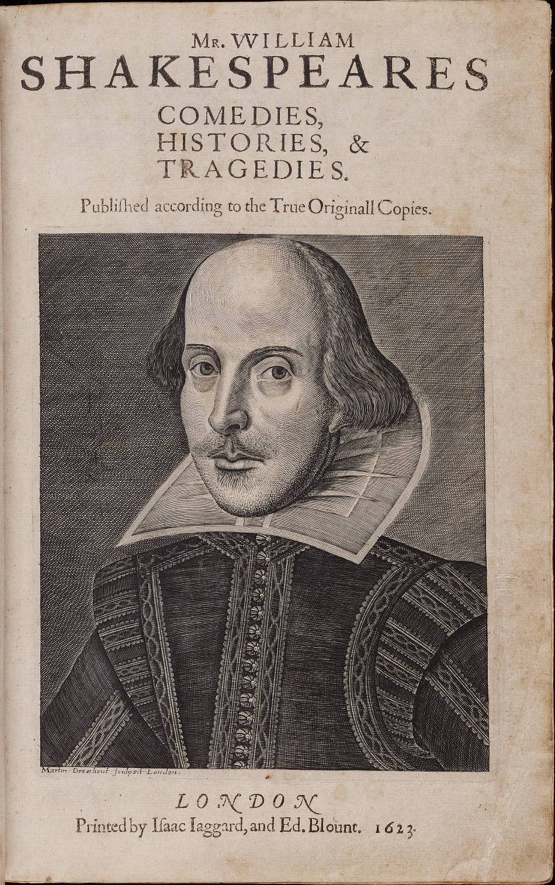
The plays the thing
Notes:
Plays become literature
Poems become literature
Are these the same thing as a book?

Slide 14
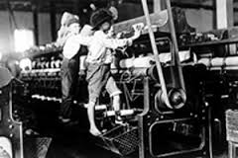
Industrialization
Notes:
Brings about the idea of a writer as a business
Also brings about the writer as an owner
Can you own the ideas?
Do you own the book?

Slide 15
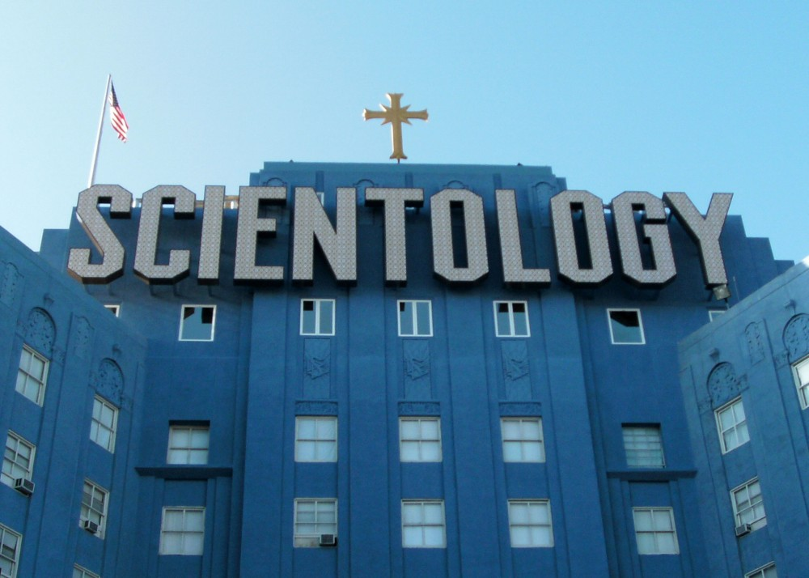
Owning the spiritual knowledge
Should a person be able to own the path to spiritual growth

Slide 16
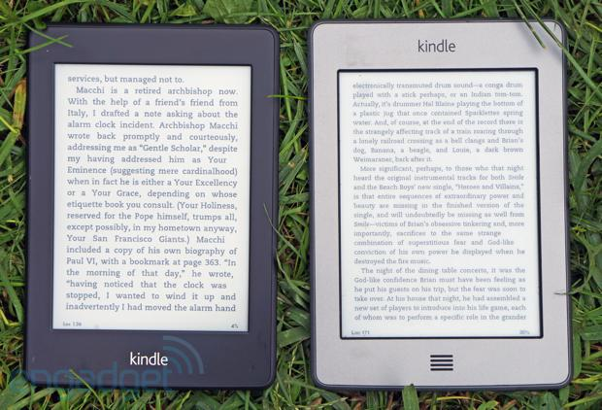
Kindling a new fire
Notes:
Removes the idea of a physical form
They exist in the cloud

Slide 17

What is the cloud?
Notes:
Organic system of computer networks that store data
Have redundancy
Genius of google
Have actual owners outside of the author and buyer
Physical incarnation of an idea

Slide 18
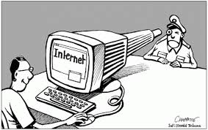
Censorship in the 21st Century
Notes:
How will the books be burned in the new world?
How does media help trigger a backlash with censorship

Slide 19

Social media
Notes:
Are posts writing?
Can they be spiritual?
Who owns their distribution?

